Slide 1

Review on NOACs Studies
Dr. Kourosh Sadeghi
Tehran University of medical sciences

Slide 2
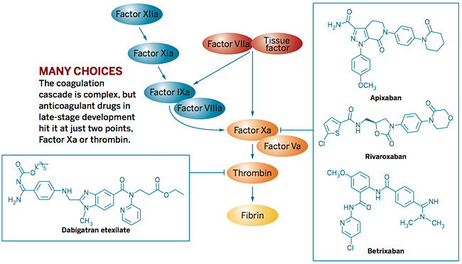

Slide 3
New Oral Anticoagulants (NOACs)
NOACs
Factor Xa Inhibitors
RIVAROXABAN
DABIGATRAN
Direct Thrombin Inhibitors
Available in Iran

Slide 4

NOACs
Clinical Trials

Slide 5
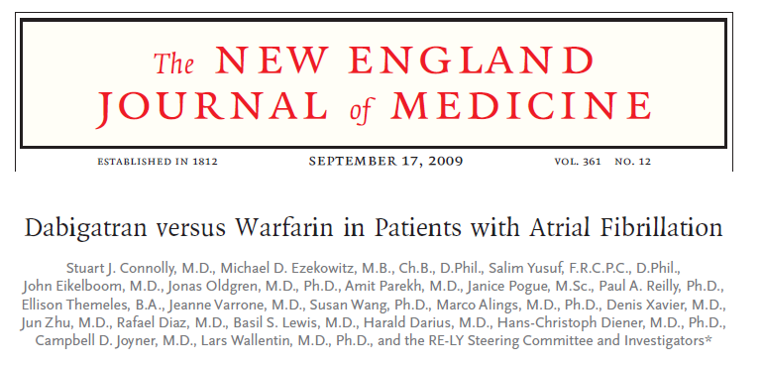
RE-LY Study
951 clinical centers in 44 countries, Non-inferiority trial, 18,113 patients, fixed doses of dabigatran 110 mg or 150 mg twice daily — or, in an un-blinded fashion, adjusted-dose warfarin.
The median duration of the follow-up period was 2.0 years.

Slide 6
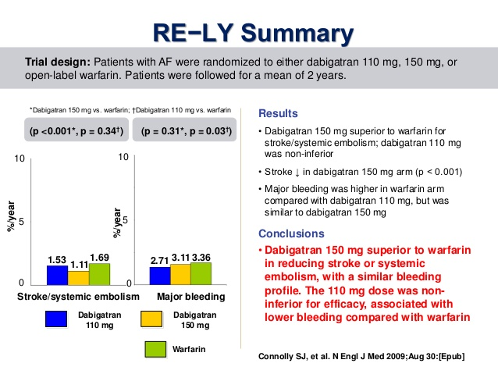
The rate of myocardial infarction was 0.53% per year with warfarin and was higher with dabigatran (0.72%) (P=0.048)

Slide 7
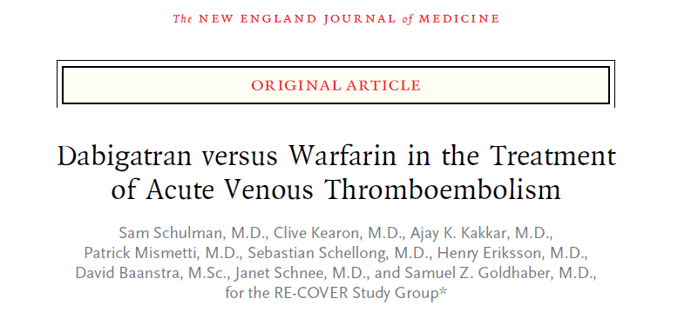
N Engl J Med 2009;361:2342-52.
A randomized, double-blind, non-inferiority trial
oral dabigatran, 150 mg twice daily, with warfarin adjusted to INR: 2.0 to 3.0
228 clinical centers in 29 countries

Slide 8
RE-COVER study
initially given parenteral anticoagulation therapy for a median of 9 days
The primary outcome was the 6-month incidence of recurrent symptomatic, objectively confirmed venous thromboembolism and related deaths.
Safety end points included bleeding events, acute coronary syndromes, other adverse events, and results of liver-function tests.
RESULTS:
A total of 30 of the 1274 patients randomly assigned to receive dabigatran (2.4%), as compared with 27 of the 1265 patients randomly assigned to warfarin (2.1%), had recurrent venous thromboembolism;
Adverse events leading to discontinuation of the study drug occurred in 9.0% of patients assigned to dabigatran and in 6.8% of patients assigned to warfarin (P = 0.05).

Slide 9
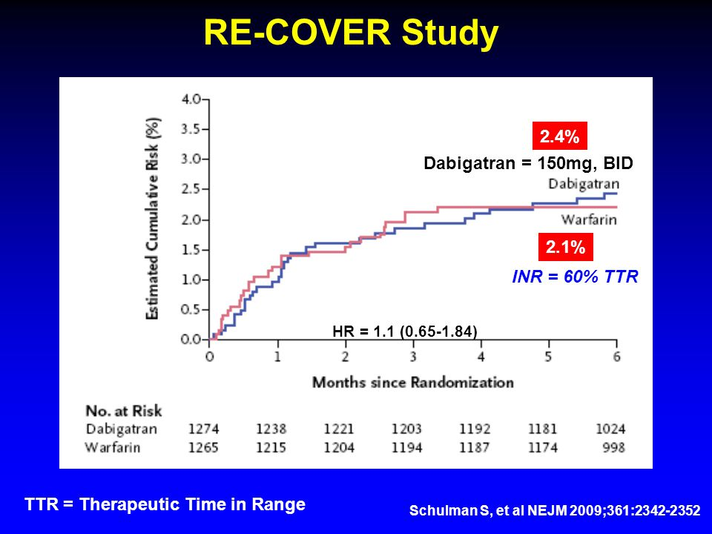

Slide 10
ROCKET AF Trial
Rivaroxaban 20mg, Qday
dose-adjusted warfarin INR 2-3
A Prospective, Randomized, Double-Blind, Parallel-Group, Multicenter, Non-Inferiority

Slide 11
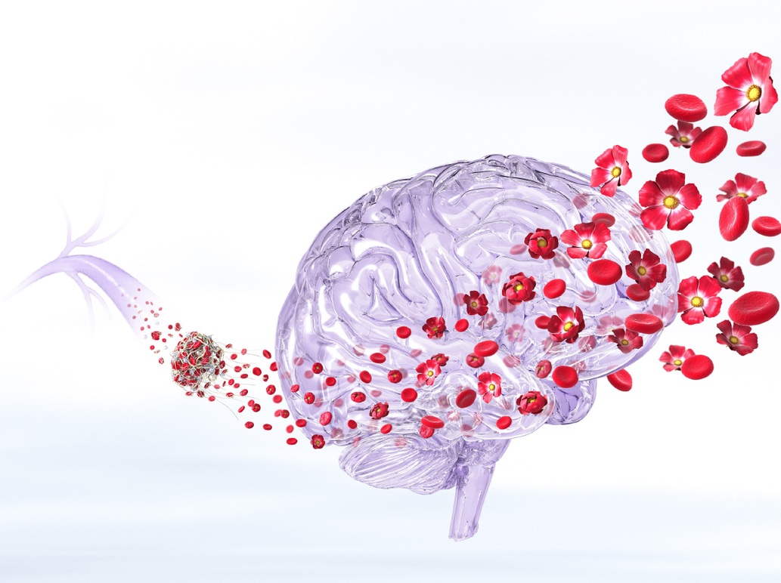
ROCKET AF Trial Summary
A double-blind trial, randomly assigned 14,264 patients with non-valvular AF
1178 participating sites in 45 countries
Primary efficacy endpoint was composite event of stroke and systemic embolism
Primary safety endpoint: major/non-major clinically relevant bleeding
Eevent rates for stroke and systemic embolism were:
  1.7% per year in the rivaroxaban group
  2.2% per year in the warfarin group
Clinically relevant bleeding event rates were:
  14.9% per year in the rivaroxaban group
  14.5% per year in the warfarin group
Intracranial hemorrhage occurred less frequently with rivaroxaban as did fatal bleeding

Slide 12
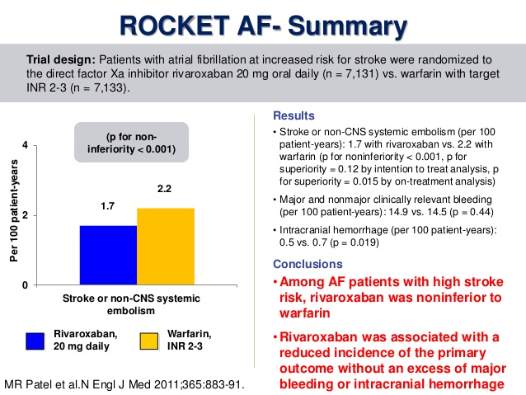

Slide 13
Rivaroxaban 15 mg, PO, BID x 3 weeks then 20mg, Qday
Enoxaparin 1mg/kg/Q12hrs bridge to Warfarin INR 2-3
Open Label, Non-Inferiority
N Engl J Med 2010;363:2499-510.

Slide 14
Einstein DVT
Rivaroxaban
15 mg, BID x 3 wks
20 mg, Qday
VTE Major Bld
2.1% 8.1%
DVT
Enoxaparin
Warfarin INR 2-3
3.0% 8.1%
3, 6, 12 months
Proximal DVT
Warfarin TTR = 57.7%
Einstein Investigators NEJM 2010;363:2499-2510

Slide 15
Einstein Acute DVT Study
Safety Outcomes
Riva
Standard
Einstein Investigators NEJM 2010;363:2499-2510

Slide 16
Rivaroxaban 15 mg, PO, BID x 3 weeks then 20mg, Qday
Enoxaparin 1mg/kg/Q12hrs bridge to Warfarin INR 2-3
Open Label, Non-Inferiority
N Engl J Med 2012;366:1287-97.

Slide 17
Einstein PE
Rivaroxaban
15 mg, BID x 3 wks
20 mg, Qday
VTE Major Bld
2.1% 1.1%
PE
Enoxaparin
Warfarin INR 2-3
Non-Inferior
1.8% 2.2%
3, 6, 12 months
Warfarin TTR = 62.7%
Einstein-PE Investigators NEJM 2012;366:1287-1297

Slide 18
The EINSTEIN-Extension study compared rivaroxaban with placebo in patients who completed their standard treatment course after venous thromboembolism (VTE), in whom there was equipoise with respect to the need for continued anticoagulation.

Slide 19
The EINSTEIN-Extension study
After 6–12 months of treatment, rivaroxaban significantly reduced the risk of recurrent VTE at the cost of a moderate increase in bleeding complications.
Overall, these results suggest that rivaroxaban can be a valid alternative to warfarin for patients requiring long-term secondary prevention of VTE.

Slide 20
RECORD 1 Trial
randomized, double-blind study

Slide 21
RECORD 1 Methods
Randomized, double-blind study, 4541 patients to receive either 10 mg of oral rivaroxaban once daily, beginning after surgery, or 40 mg of enoxaparin subcutaneously once daily, beginning the evening before surgery.
The primary efficacy outcome was the composite of deep-vein thrombosis, nonfatal pulmonary embolism, or death from any cause at 36 days.
The main secondary efficacy outcome was major venous thromboembolism (proximal deep-vein thrombosis, nonfatal pulmonary embolism, or death from venous thromboembolism).
The primary safety outcome was major bleeding.

Slide 22
RECORD 1 Results
The primary efficacy outcome occurred in 1.1% in the rivaroxaban group and in 3.7% in the enoxaparin group (absolute risk reduction, 2.6%; P<0.001).
Major venous thromboembolism occurred in 0.3% in the rivaroxaban group and in 2.0% in the enoxaparin group (absolute risk reduction, 1.7%; P<0.001).
Major bleeding occurred in 0.3% in the rivaroxaban group and in 0.1% in the enoxaparin group (P = 0.18).

Slide 23
RECORD1: summary
5
Rivaroxaban 10 mg once daily
Total VTE
Enoxaparin 40 mg once daily
4
RRR 70%
3
Major VTE
Incidence (%)
RRR 88%
2
Symptomatic VTE
1
Major bleeding
3.7%
1.1%
2.0%
0.2%
0.5%
0.3%
0.1%
0.3%
0

Slide 24
Conclusions
RECORD 1 Trial
A once-daily, 10-mg oral dose of rivaroxaban was significantly more effective for extended thromboprophylaxis than a once-daily, 40-mg subcutaneous dose of enoxaparin in patients undergoing elective total hip arthroplasty.
The two drugs had similar safety profiles

Slide 25
RECORD 3 Trial
randomized, double-blind trial,

Slide 26
RECORD 3 Methods
Randomized, double-blind trial, 2531 patients who were to undergo total knee arthroplasty received either oral rivaroxaban, 10 mg once daily, beginning 6 to 8 hours after surgery, or subcutaneous enoxaparin, 40 mg once daily, beginning 12 hours before surgery.
The primary efficacy outcome was the composite of any deep-vein thrombosis, nonfatal pulmonary embolism, or death from any cause within 13 to 17 days after surgery.
Secondary efficacy outcomes included major venous thromboembolism (i.e., proximal deep-vein thrombosis, nonfatal pulmonary embolism, or death related to venous thromboembolism) and symptomatic venous thromboembolism.
The primary safety outcome was major bleeding.

Slide 27
RECORD 3 Results
The primary efficacy outcome occurred in 9.7% who received rivaroxaban and in 18.9% who received enoxaparin (absolute risk reduction, 9.2%; P<0.001).
Major venous thromboembolism occurred in 1.0% given rivaroxaban and 2.6% given enoxaparin (absolute risk reduction, 1.6%; P = 0.01).
Symptomatic events occurred less frequently with rivaroxaban than with enoxaparin (P = 0.005).
Major bleeding occurred in 0.6% of patients in the rivaroxaban group and 0.5% of patients in the enoxaparin group (P = 0.77).
The incidence of drug-related adverse events, mainly gastrointestinal, was 12.0% in the rivaroxaban group and 13.0% in the enoxaparin group (P = NS).

Slide 28
RECORD 3 Trial
Conclusions
Rivaroxaban was superior to enoxaparin for thromboprophylaxis after total knee arthroplasty, with similar rates of bleeding.

Slide 29
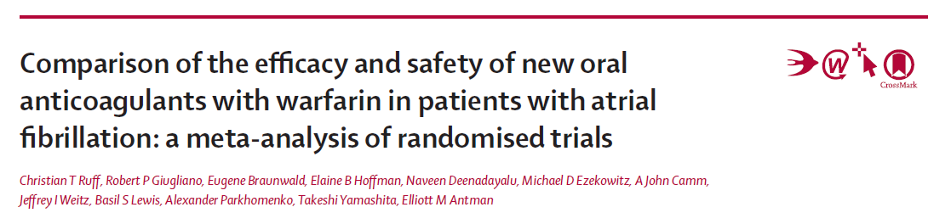
Lancet 2014; 383: 955–62
a meta-analysis of all 71 683 participants
included in the RE-LY, ROCKET AF, ARISTOTLE, and ENGAGE AF–TIMI 48 trials
The main outcomes were stroke and systemic embolic events, ischaemic stroke, haemorrhagic stroke, all-cause mortality, myocardial infarction, major bleeding, intracranial haemorrhage, and gastrointestinal bleeding.
relative risks (RRs) and 95% CIs for each outcome were calculated

Slide 30
Findings
42 411 participants received a new oral anticoagulant and 29 272 participants received warfarin.
New oral anticoagulants significantly reduced stroke or systemic embolic events by 19% compared with warfarin (RR 0·81, 95% CI 0·73–0·91; p<0·0001)
And a reduce in haemorrhagic stroke (0·49, 0·38–0·64; p<0·0001)
significantly reduced all-cause mortality (0·90, 0·85–0·95; p=0·0003) and intracranial haemorrhage (0·48, 0·39–0·59; p<0·0001),
but increased gastrointestinal bleeding (1·25, 1·01–1·55; p=0·04).
Conclusion:
NOACs had a favorable risk–benefit profile, with significant reductions in stroke, intracranial haemorrhage, and mortality, and with similar major bleeding as for warfarin, but increased gastrointestinal bleeding. The relative efficacy and safety of new oral anticoagulants was consistent across a wide range of patients.

Slide 31
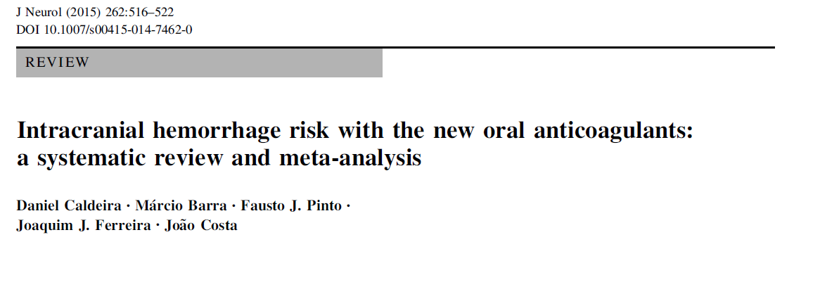

Slide 32
A systematic review and meta-analysis of phase III randomized controlled trials (RCTs) comparing NOACs versus any control and reporting ICH events.
18 RCTs evaluating 148,149 patients were included.
In comparison to other anticoagulant regimens (considered the standard of care in each condition), the risk of ICH was reduced to more than an half with the NOACs
NOACs are at least as effective as VKA/LMWH in the studied conditions and significantly decreased ICH risk

Slide 33
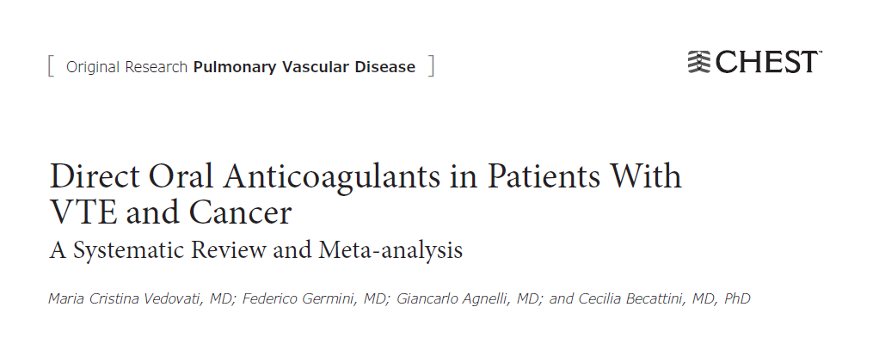
CHEST 2015; 147(2):4 75- 483
Six studies were included in the meta-analysis (two with dabigatran, two with rivaroxaban, one with edoxaban, and one with apixaban), accounting for a total of 1,132 patients with cancer.

Slide 34
Results
VTE recurred in 3.9% and in 6.0% patients with cancer treated with DOAs and conventional treatment, respectively (OR, 0.63; 95% CI, 0.37-1.10)
Major Bleeding occurred in 3.2% and 4.2% of patients receiving DOAs and conventional treatment, respectively (OR, 0.77; 95% CI, 0.41-1.44).
A Non-significant reduction of recurrent VTE of about 40% in favor of DOAs compared with conventional treatment with heparin followed by vitamin K antagonists. The reduction was consistent across all the included studies

Slide 35
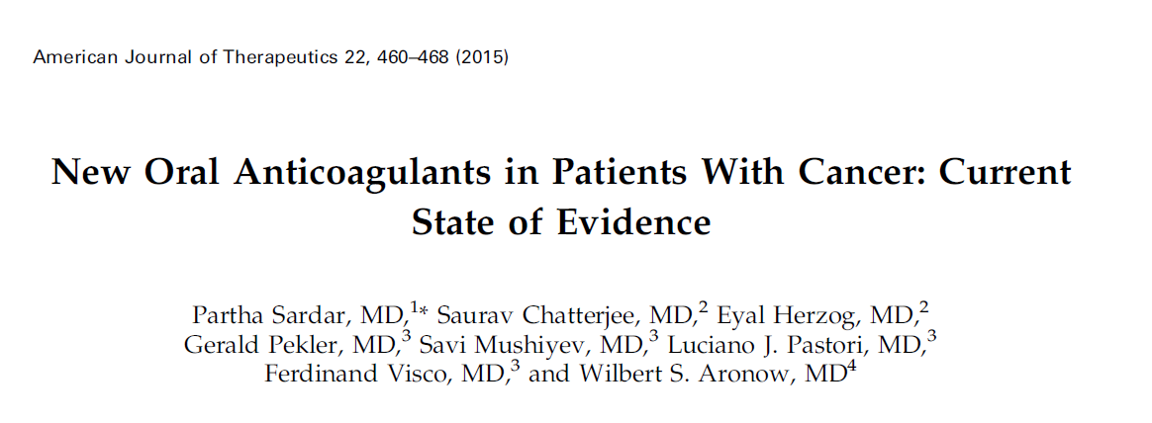

Slide 36
Six trials randomized 19,832 patients, and 1197 patients had cancer.
Risk of VTE or VTE-related death was not significantly different with NOAC versus control (LMWH/VKA) in patients with cancer
Clinically relevant bleeding was not higher with NOAC compared with control (OR, 1.49; 95% CI, 0.82–2.71);
No statistically significant difference of efficacy and safety with NOAC was found between patients with and without cancer.
Rivaroxaban might be equally effective and safe as vitamin K antagonist in patients with cancer.
Dabigatran is as effective as comparator; however, safety profile of dabigatran is unknown.

Slide 37

THANK YOU

