Slide 1


Slide 2
TREATMENT OF ACUTE PULMONARY THROMBOEMB0LISM
SEYED REZA SEYEDI.MD

Slide 3
Anticoagulation preventing both early death & recurrent VTE
In intermediate or high clinical probability parenteral anticoagulation should be initiated whilst awaiting for results of diagnostic tests.
LMWH or fondaparinux are preferred over UFH(major bleeding &HIT)
UFH is recommended for CrCl<30 ml/min or severe obesity

Slide 4
For LMWH anti-Xa level check during pregnancy (after 4h)
Target level : 0.6-1 Iu/ml (BD) and 1-2 Iu/ml (once daily)
Fondaparinux : selective Xa inhibitor, once daily,weight adjusted dose,without monitoring
Recurrent VTE & major bleeding similar to UFH (without HIT)

Slide 5
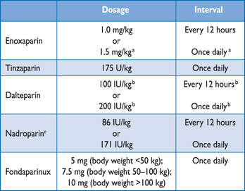

Slide 6
Fondaparinux contraindicated in ClCr<30 ml/min & ClCr 30-50 dose reduced by 50%
ORAL ANTICOAGULATION:
Should be initiated as soon as possible(same day as parenteral)
Warfarin started with 10 mg in younger healthy outpatients and 5mg in older and hospitalized

Slide 8
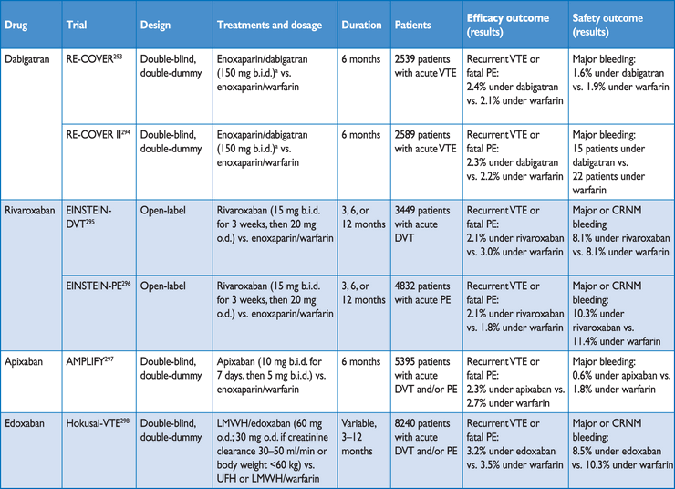

Slide 12
EINSTEIN trial : compared rivaroxaban with enoxaparin/warfarin :
Rivaroxaban was non-inferior to standard therapy
Safety outcome was similar but major bleeding was less in rivaroxaban group

Slide 13
RE-COVER trial :compared dabigatran with warfarin:
Dabigatran was non-inferior to warfarin & no differences in major bleeding & fewer episodes of any bleeding
RECOVER II confirmed results

Slide 14
AMPLIFY STUDY :
Apixaban was non-inferior to conventional therapy & less chance for major bleeding
HOKUSAL STUDY:
Edoxaban was non-inferior to warfarin & major and non major bleeding was less (3.3% against 6.2%)

Slide 18
In patient who have recurrent VTE on VKA or NOAC we suggest switching to LMWH at least temporarily
In patient who have recurrent VTE on long term LMWH we suggest increasing dose 1/4 to 1/3
Risk of bleeding is lower with apixaban than other NOAC

Slide 19
AT10 suggest NOAC to VKA for initial & long term for VTE
AT9 Suggested same anticoagulant was used in initial part should be used after 3 or 6 months but AT10 suggest no obligation to switch
According to AT10 apixaban 5mg BD change to 2.5 mg BD for extended therapy

Slide 20
Rivaroxaban ,dabigatran & apixaban are approved for VTE(2014) & edoxaban(2016)
THROMBOLITIC TREATMENT:
Restore perfusion more rapidly
Regimens over 2h preferable to 12-24h
Reteplase and desmoteplase compred with rtPA :
Similar results in haemodynamic parameters

Slide 21
UFH should be stopped during injection of SK or UK and can be continued during rtPA
Infusion of UFH delayed until 12h after LMWH (BD) or 24h (once daily)
Over all>90% of patient respond to thrombolysis (clinical & echo cardiographic within 36h)

Slide 22
Greatest binifit of treatment :initiate in 48h but can be use for 6-14 days
In hospital mortality lower with thrombolytic in unstable patient
PEITHO trial compared tenectaplase plus heparin VS placebo plus heparin in RV dysfunction:
All cause death & haemodynamic decompensation significantly reduced

Slide 31


